Slide 1


          University of Diyala
          College of Engineering
          Department of Electronics Engineering
Course Number: U103
Course Name: Computer Networks
Lecture (7)
Asst. Lect. Ahmed Mohammed Ahmed

Slide 2
Time-Division Multiplexing
Time-division multiplexing (TDM) is a digital process that allows several connections to share the high bandwidth of a link. Instead of sharing a portion of the bandwidth as in FDM, time is shared. Each connection occupies a portion of time in the link. Figure (1) gives a conceptual view of TDM. Note that the same link is used as in FDM; here, however, the link is shown sectioned by time rather than by frequency. In the figure, portions of signals 1, 2, 3, and 4 occupy the link sequentially.

Slide 3
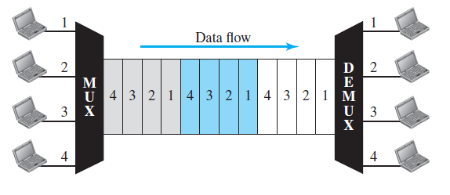

Slide 4
Synchronous TDM
In synchronous TDM, each input connection has an allotment in the output even if it is not sending data.
Time Slots and Frames
In synchronous TDM, the data flow of each input connection is divided into units, where each input occupies one input time slot. A unit can be 1 bit, one character, or one block of data. Each input unit becomes one output unit and occupies one output time slot. However, the duration of an output time slot is n times shorter than the duration of an input time slot. If an input time slot is T s, the output time slot is T/n s, where n is the number of connections. In other words, a unit in the output connection has a shorter duration; it travels faster. Figure (2) shows an example of synchronous TDM where n is 3.

Slide 5
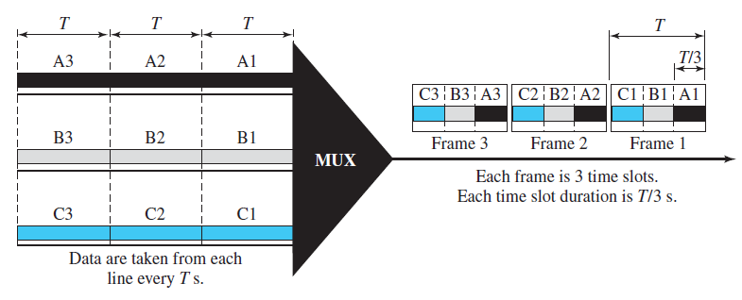

Slide 6
Example 1
In Figure (2), the data rate for each input connection is 1 kbps. If 1 bit at a time is multiplexed (a unit is 1 bit), what is the duration of
1. Each input slot,
2. Each output slot, and
3. Each frame?

Slide 7
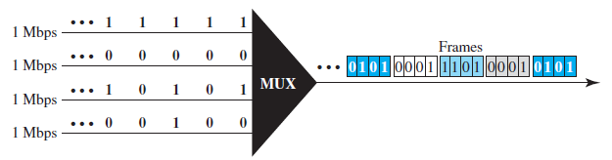
Example 2
Figure (3) shows synchronous TDM with a data stream for each input and one data stream for the output. The unit of data is 1 bit. Find (1) the input bit duration, (2) the output bit duration, (3) the output bit rate, and (4) the output frame rate.

Slide 8
Statistical Time-Division Multiplexing
As we saw in the previous section, in synchronous TDM, each input has a reserved slot in the output frame. This can be inefficient if some input lines have no data to send. In statistical time-division multiplexing, slots are dynamically allocated to improve bandwidth efficiency. Only when an input line has a slot’s worth of data to send is it given a slot in the output frame. In statistical multiplexing, the number of slots in each frame is less than the number of input lines. The multiplexer checks each input line in round-robin fashion; it allocates a slot for an input line if the line has data to send; otherwise, it skips the line and checks the next line. Figure (4) shows a synchronous and a statistical TDM example. In the former, some slots are empty because the corresponding line does not have data to send. In the latter, however, no slot is left empty as long as there are data to be sent by any input line.

Slide 9
